Slide 1

Upper Sudderth Revitalization Project
Village of Ruidoso, New Mexico
Public Meeting
May 15, 2025

Slide 2
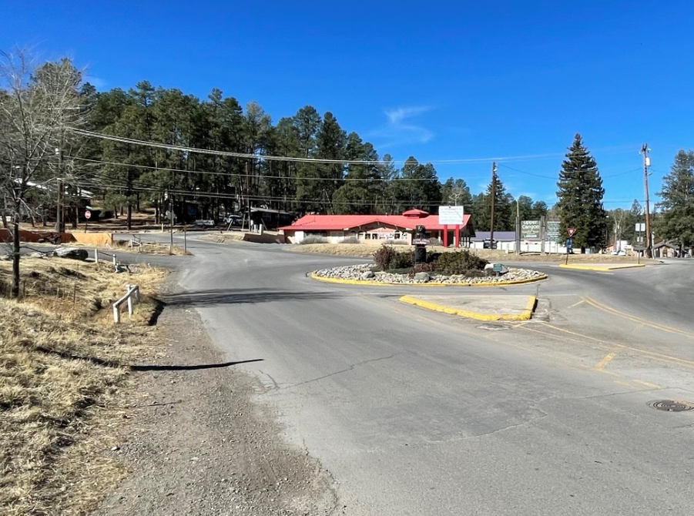
Presentation Topics/Agenda
Project Location and Overview
Study Team
Project History Purpose
Current Scope of Work
Public Involvement Plan
Preliminary Alternatives - Concept A-F
Parking Accommodations
Bicycle Facilities Accommodations
Gateway Signage
Your Input

Slide 3



Study Team
Village of Ruidoso
  Ron Sena, Village Manager
  Micheal Martinez, Deputy Village Manager
  Alex Koenig, Community Development Director, Project Manager
  Mathew Baird, Parks and Recreation Director
  Vyanca Vega, Capital Projects Coordinator
  Chrysanti Jones, Community Development Assistant
Stantec
  Gene Paulk, P.E., Senior Project Manager
  Gabby Contreras-Apodaca, P.E., Senior Associate
Barr Engineering
  John Taschek, Environmental Scientist

Slide 4
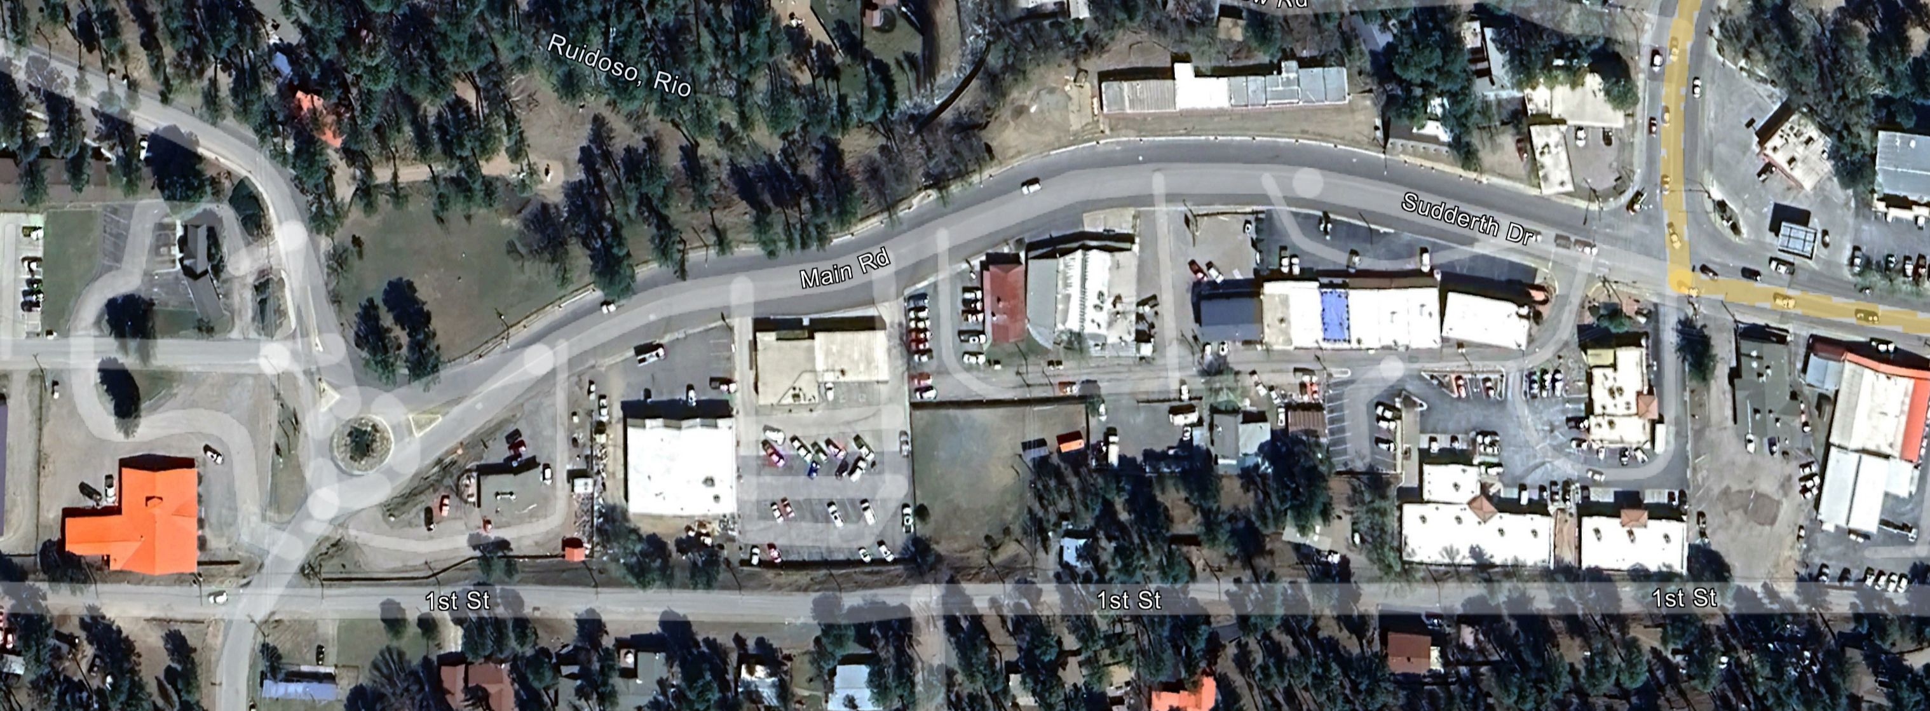
Project Location and Overview
Mechem Drive
Sudderth Drive
Main Road
Vision Drive
D Street

Slide 5
Project History and Purpose
2022: Historic Upper Canyon Gateway and Streetscape Improvements Project
2023: Stantec Fee Estimate for Corridor Study and Design
2024: U.S. Economic Development Administration Grant Metropolitan Redevelopment and Regional Job Growth

Slide 6
Current Scope of Work
Scoping Report
Public Involvement Plan
Environmental Investigation and Documentation
Engineering Design Support Studies
Preliminary Roadway Design Plans
Final Roadway Design Plans

Slide 7
Public Involvement Plan
TASK | MAR |  |  |  | APR |  |  |  | MAY |  |  |  | JUNE |  |  |  | JULY |  |  |  | AUG |  |  |  | SEPT
Study Team Meetings
Public Involvement Plan
1st Stakeholder Meeting
2nd Stakeholder Meeting
1st Public Meeting
2nd Public Meeting
3rd Public Meeting
Project Study Team
Project Website
Stakeholder Meetings
Public Meetings
TODAY

Slide 8
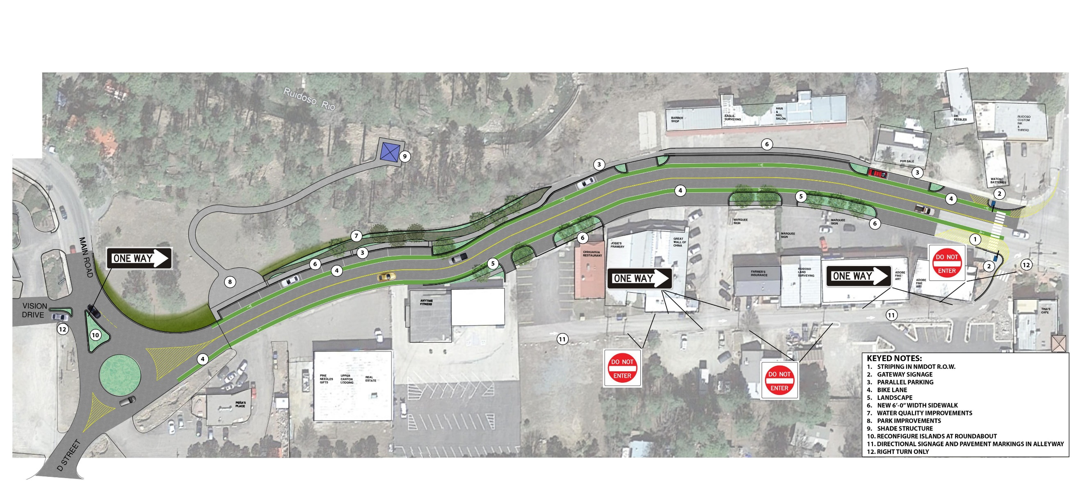
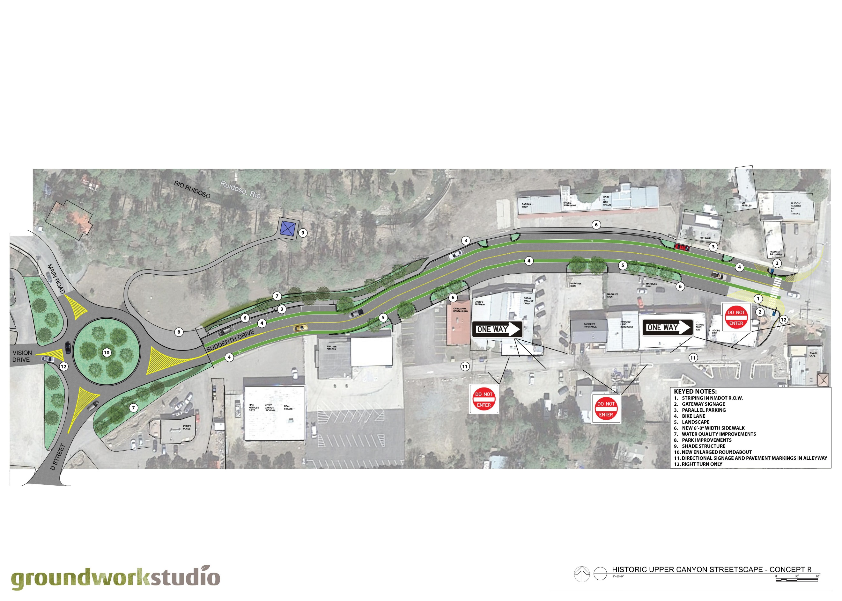

Preliminary Alternative - Concept A

Slide 9
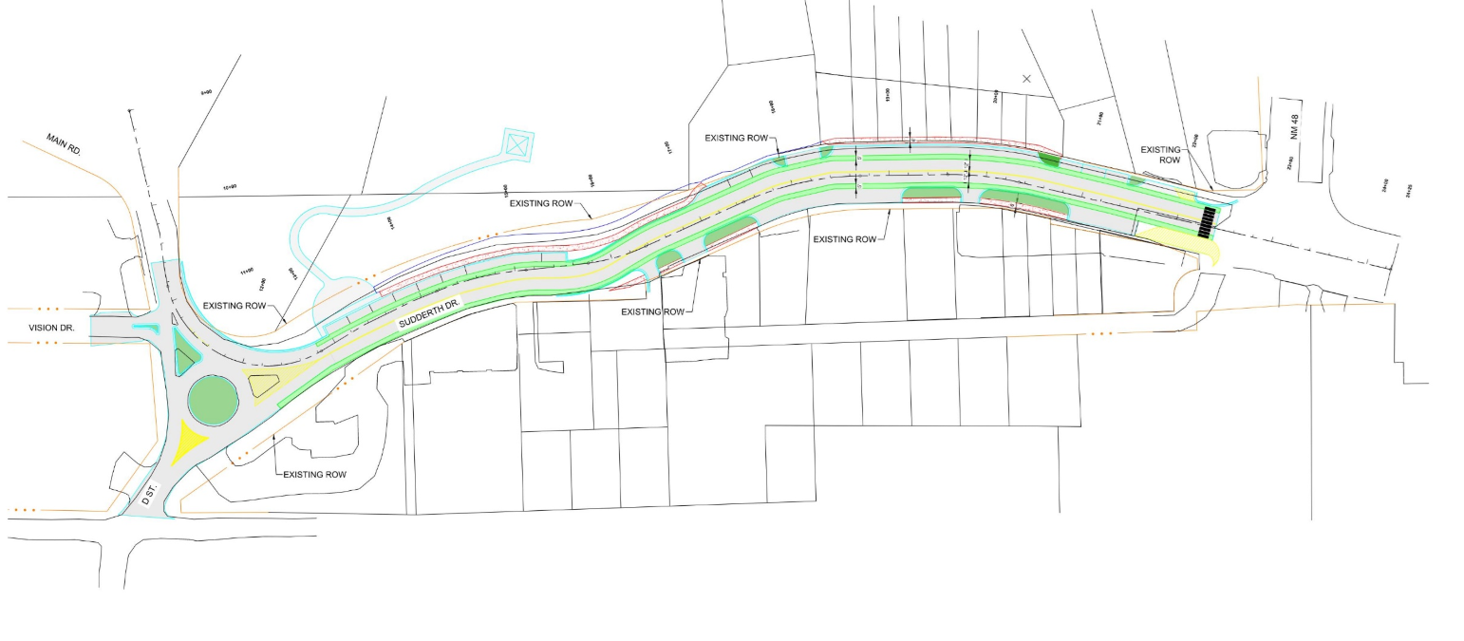
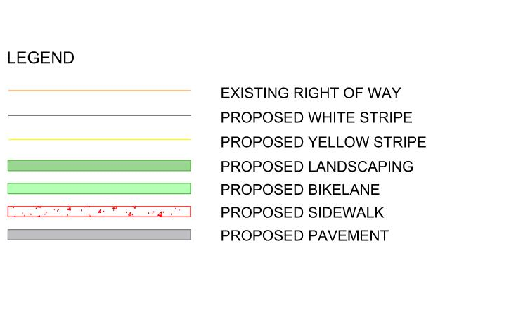
Property Layout – Concept A

Slide 10
Preliminary Alternative - Concept B

Slide 11
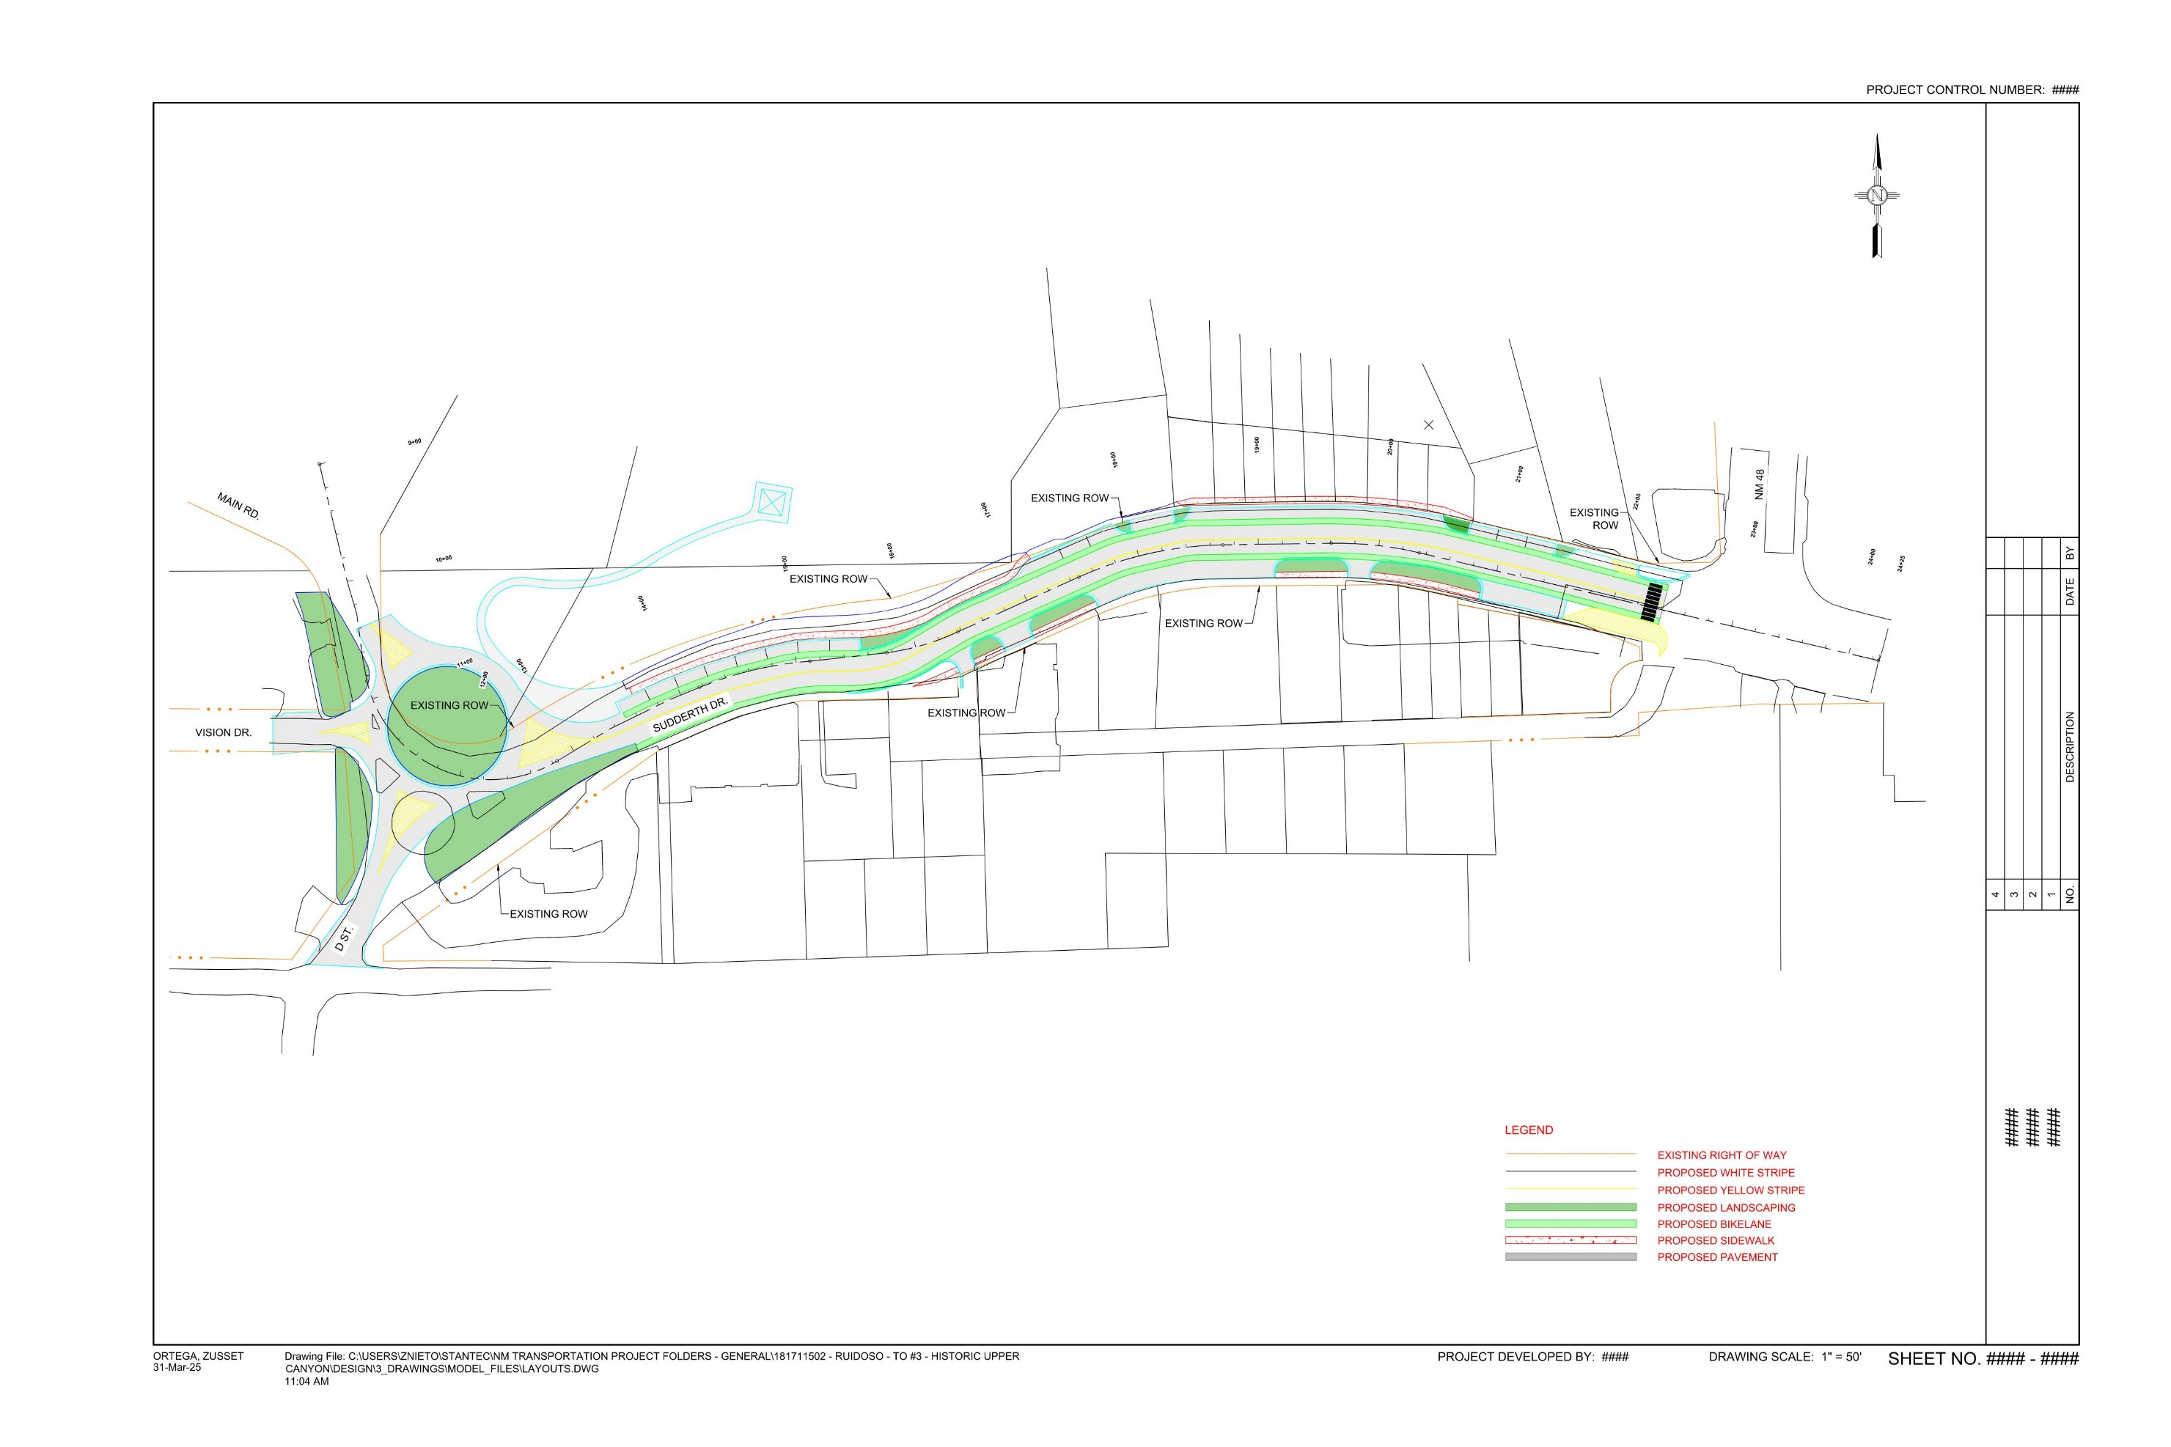
Property Layout – Concept B

Slide 12
Property Layout – Concept B

Slide 13
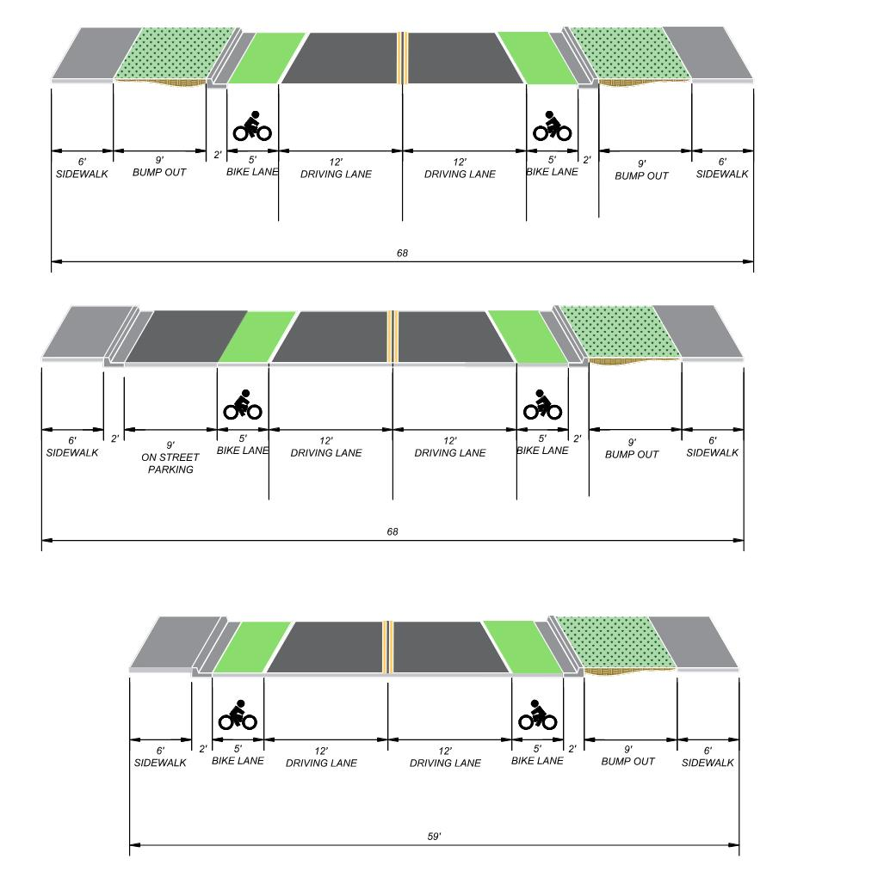
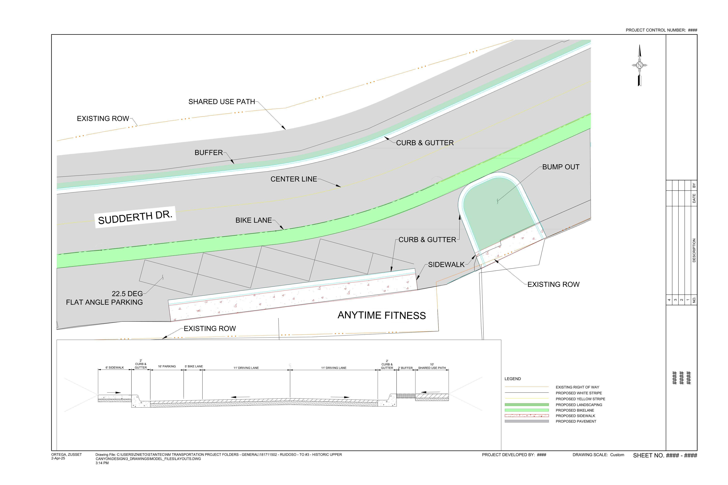
Preliminary Alternative - Concept A&B

Slide 14
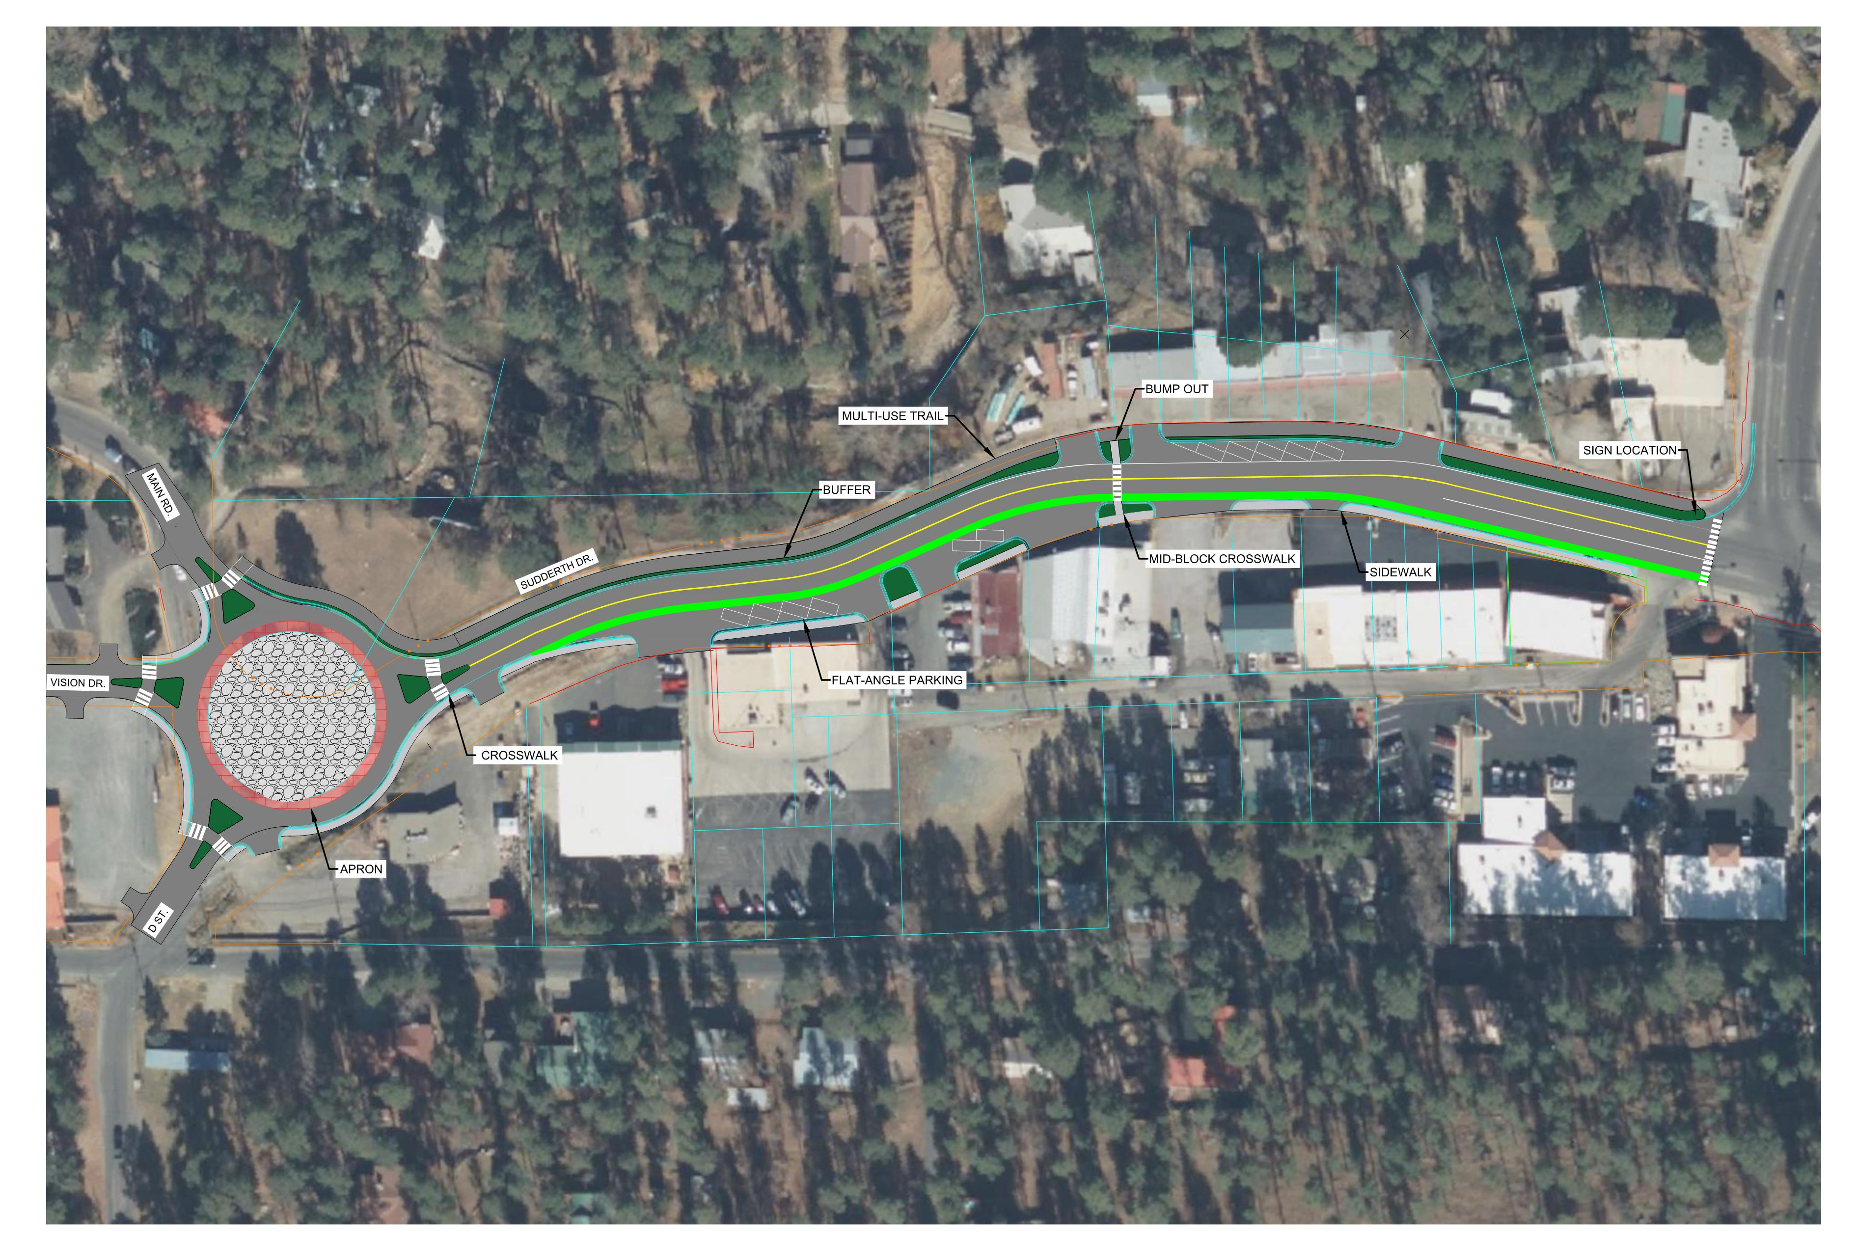
Preliminary Alternative - Concept C

Slide 15
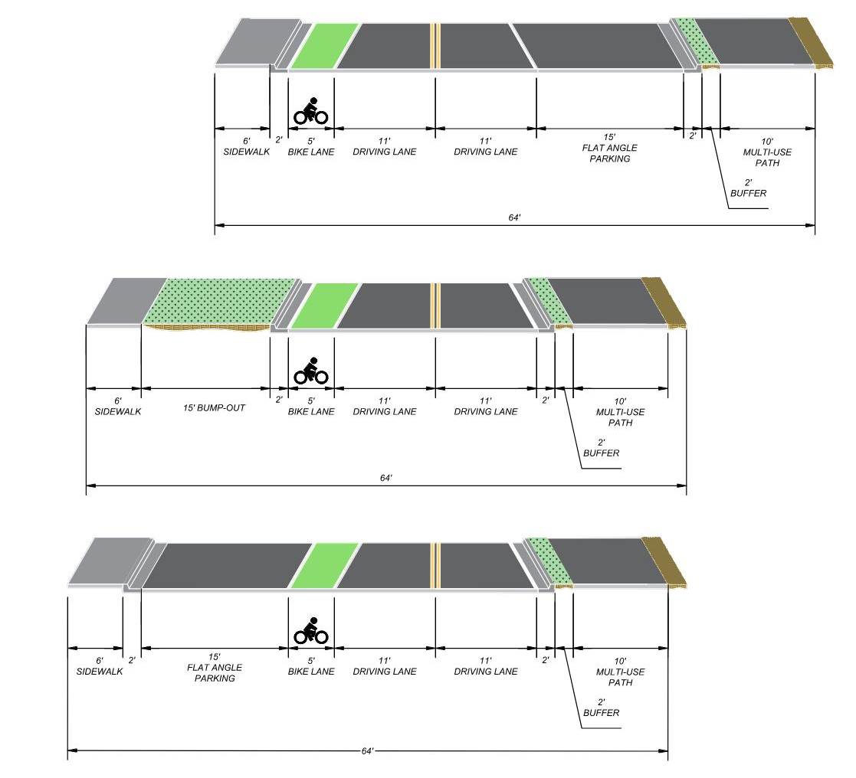
Preliminary Alternative - Concept C

Slide 16
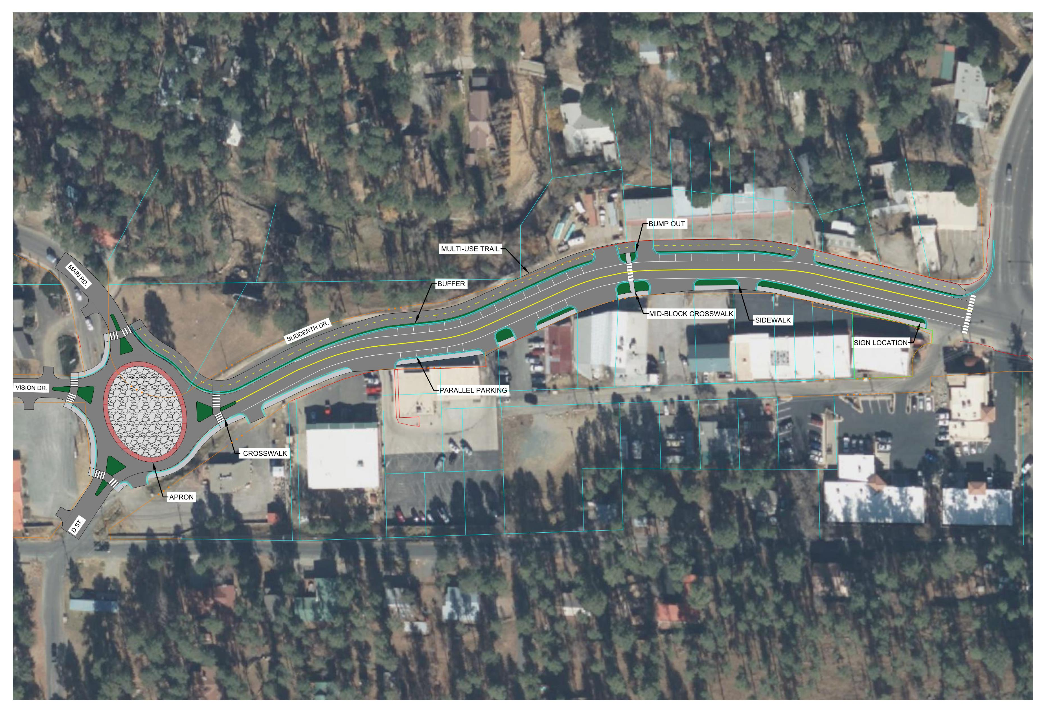
Preliminary Alternative - Concept D

Slide 17
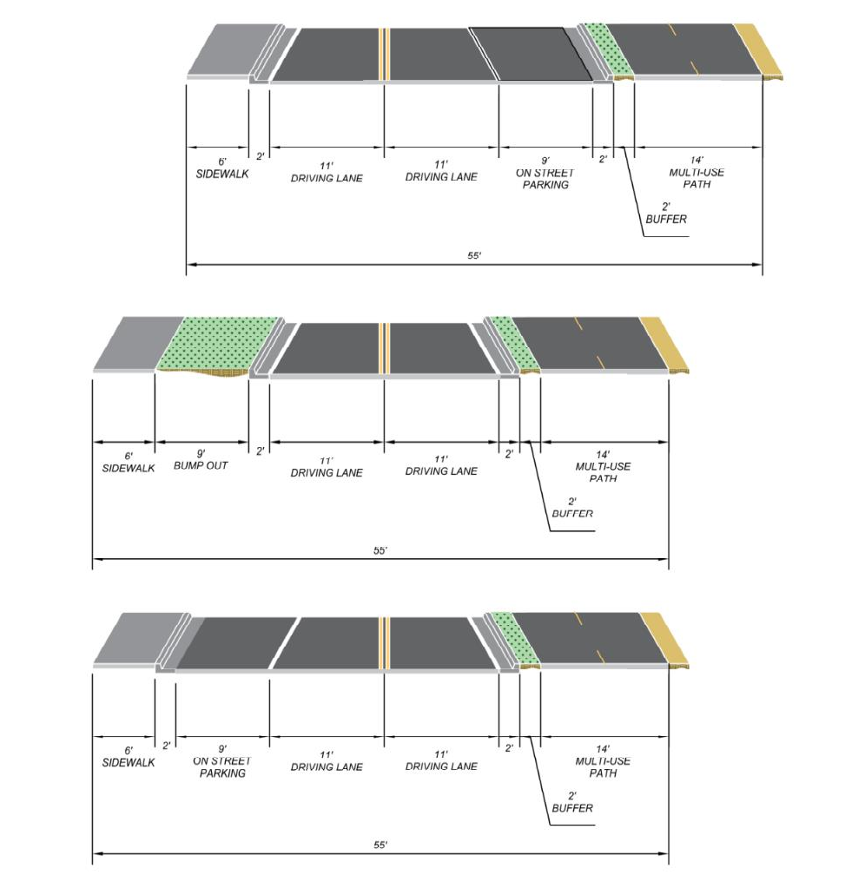
Preliminary Alternative - Concept D

Slide 18
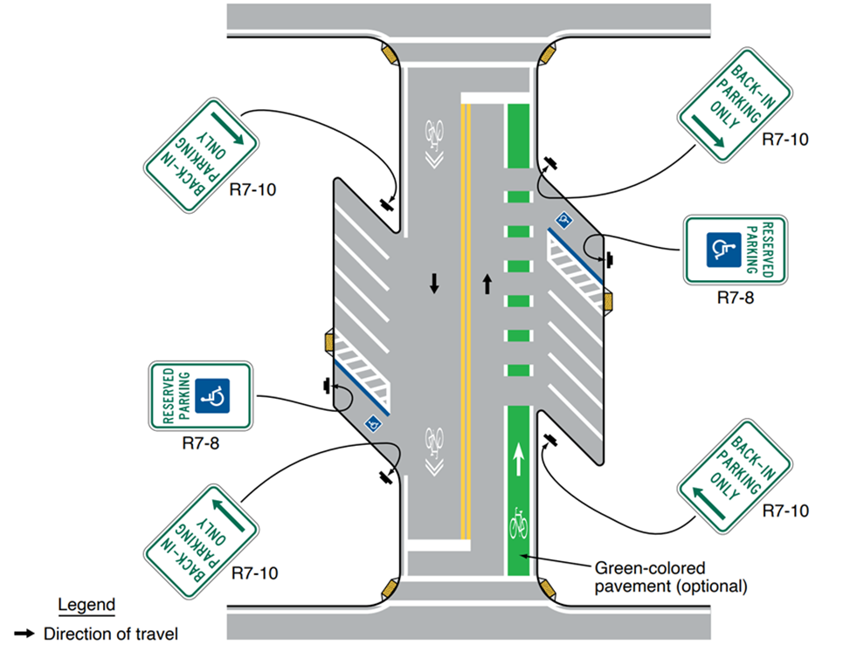
Bicycle Facilities Accommodations
Manual on Uniform Traffic Control Devices (MUTCD) Section 9B.10

Slide 19
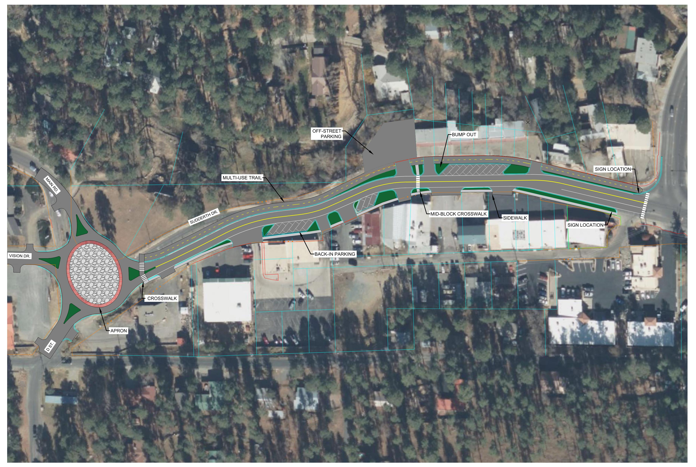
Preliminary Alternative - Concept E

Slide 20
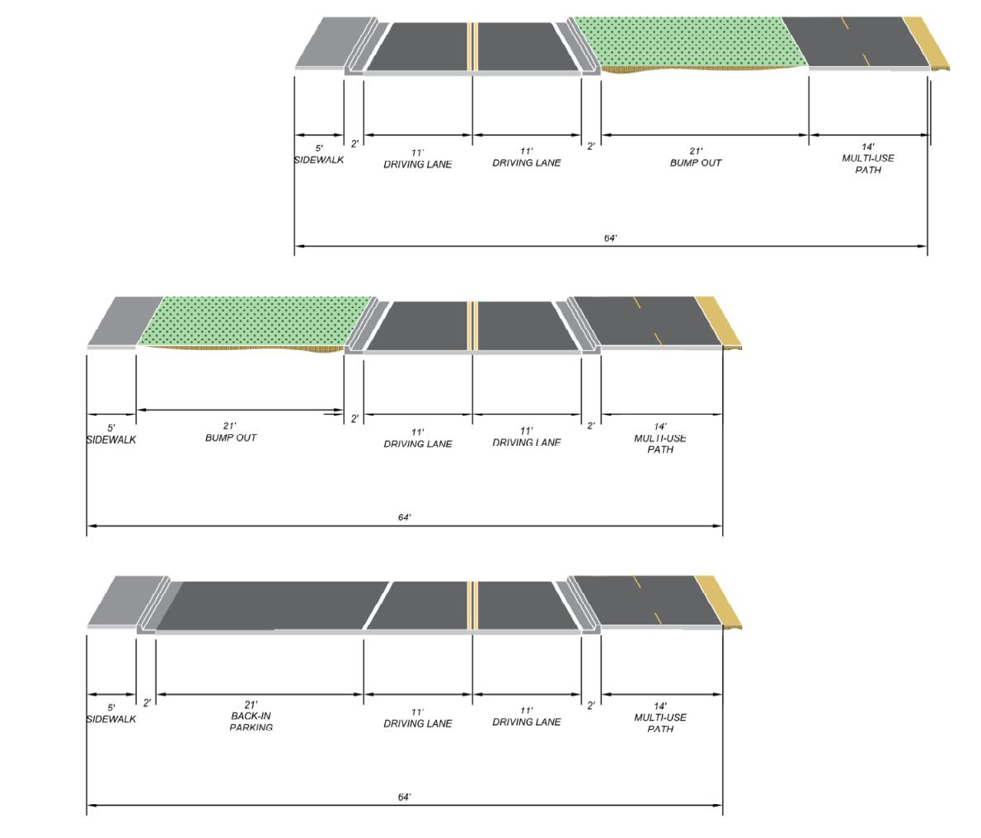
Preliminary Alternative - Concept E

Slide 21
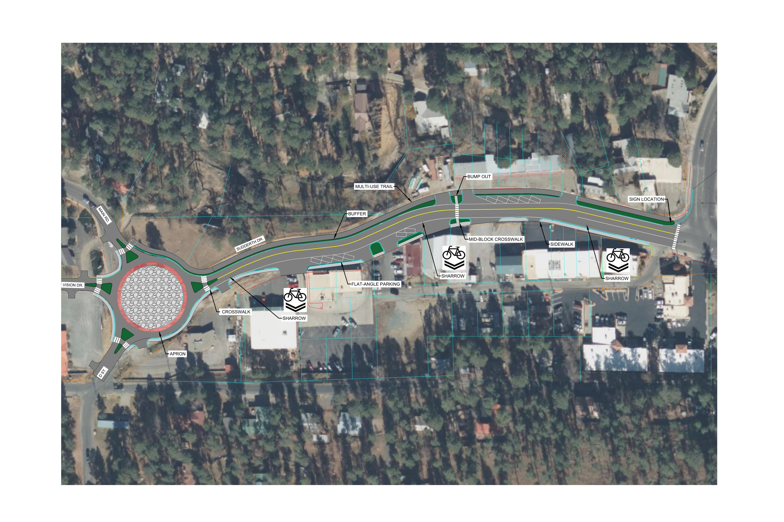
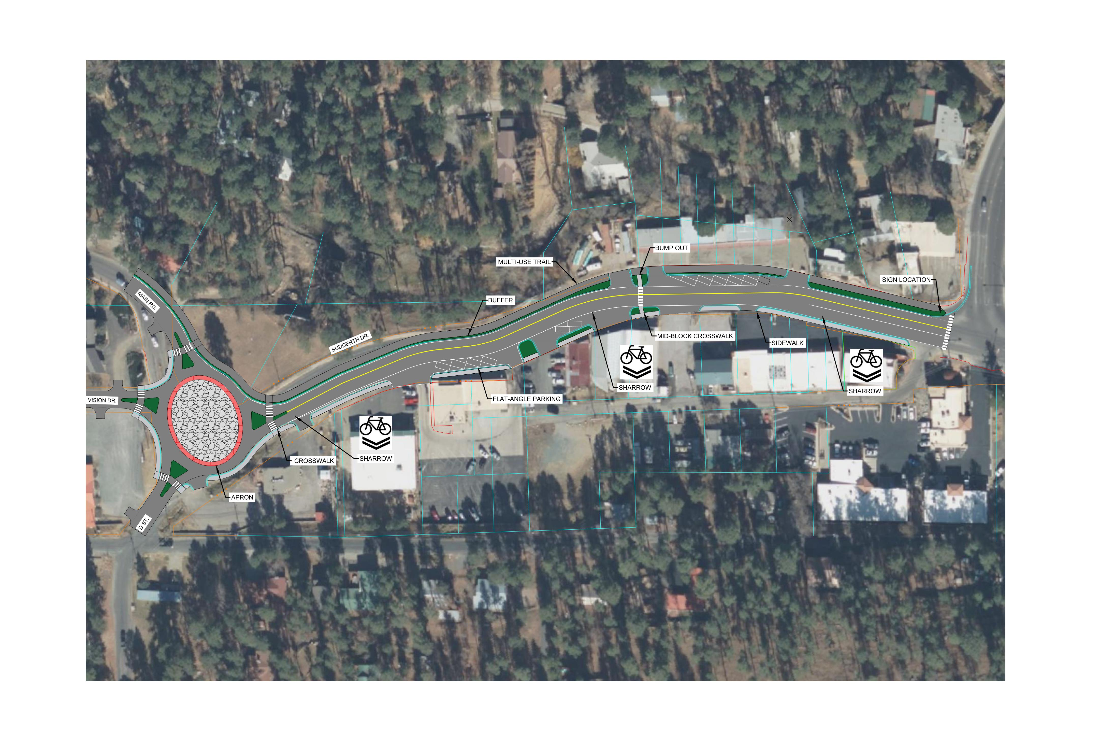
Preliminary Alternative –
Concept F

Slide 22
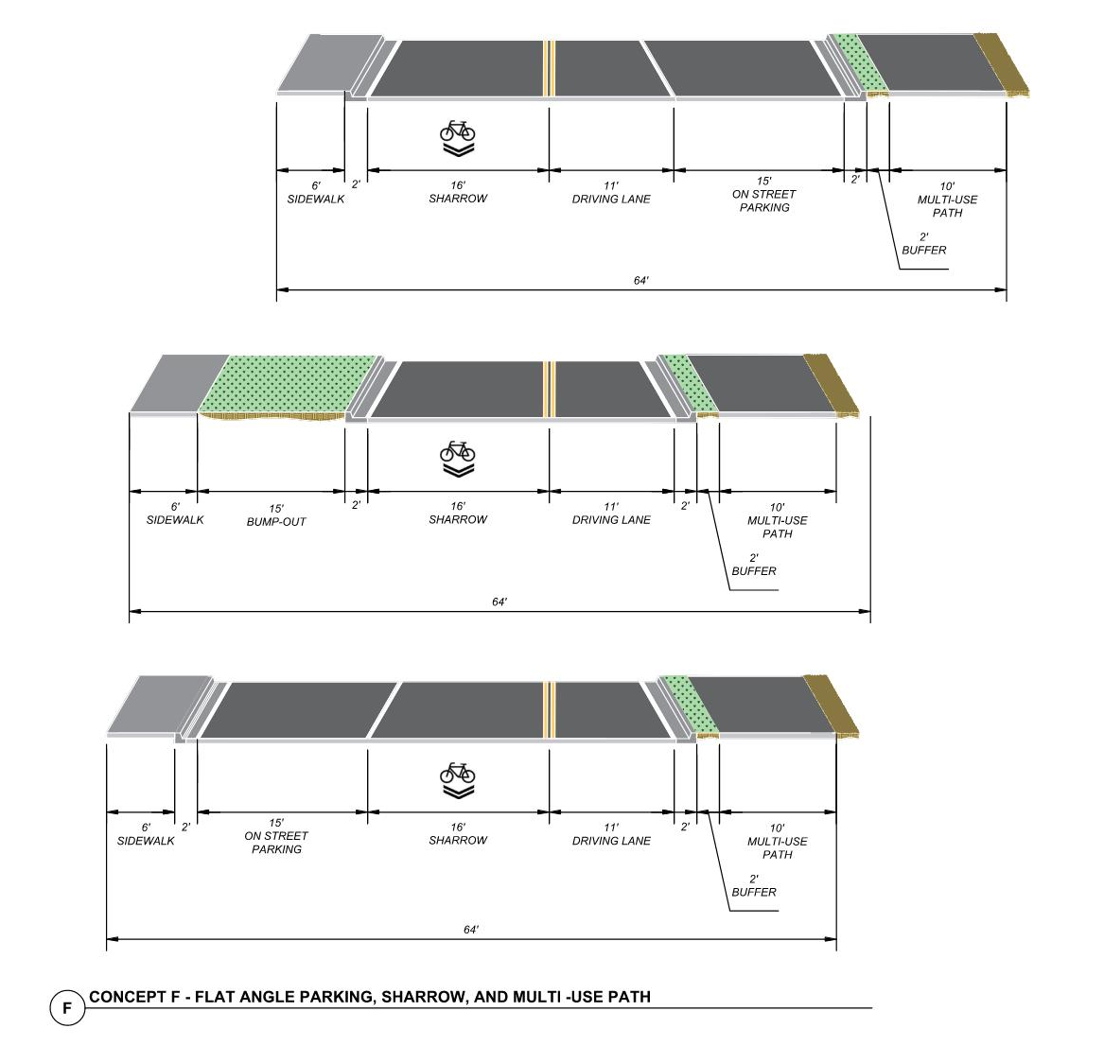
Preliminary Alternative - Concept F

Slide 23
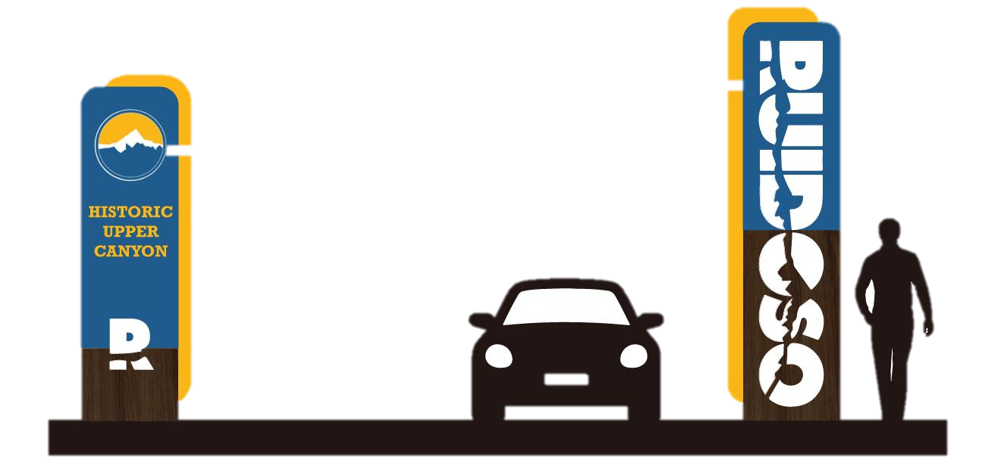



Gateway Signage 03

Slide 24
Gateway Signage 03

Slide 25
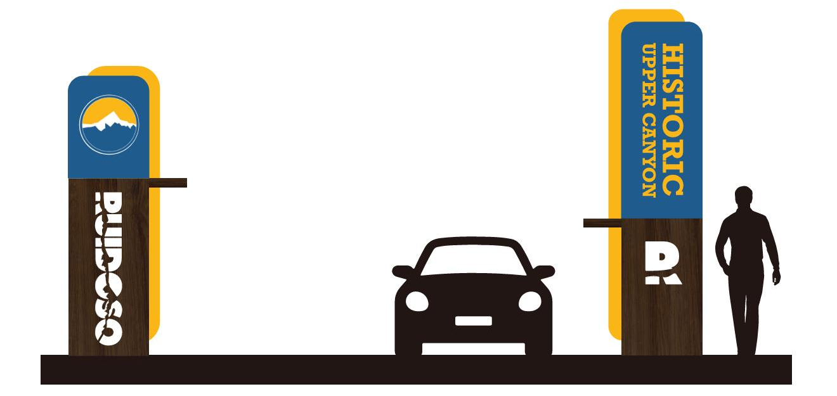
Gateway Signage 05

Slide 26
Gateway Signage 05

Slide 27
We Want to Hear Your Ideas!
Comments here at the meeting or in the future to:
www.usrp-ruidoso.com
John Taschek
Barr Engineering
320 Osuna Road NE, Suite G-4
Albuquerque, NM 87107
505-980-0993
jtaschek@barr.com

